Slide 1

ML/DL for Everyone with
Lecture 2: Computational Graph

Slide 2
Computational Graph
Use nodes and edges to represent complex math problems.

Slide 3
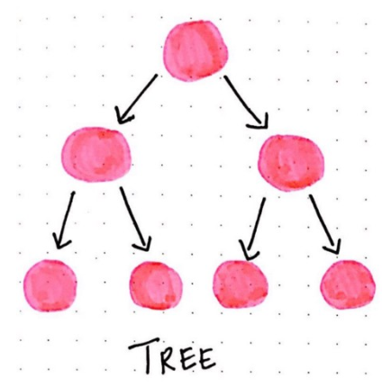

Slide 4
Free up a Tree
Remove all rules, numbers, directions, edges....

Slide 5
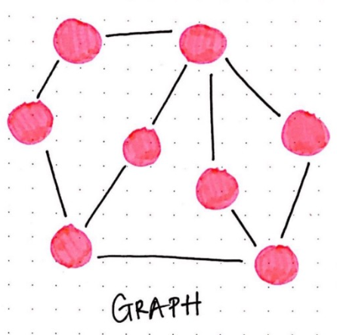

Slide 6
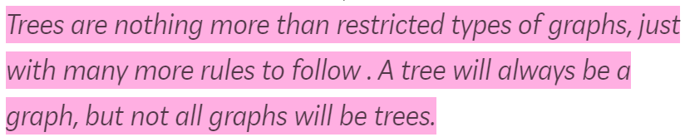

Slide 7
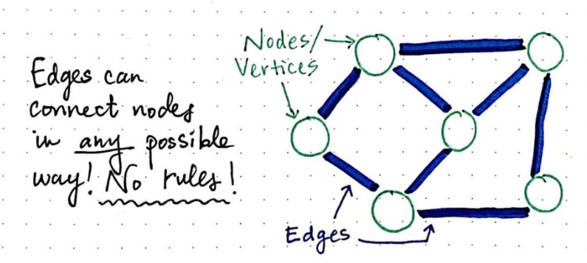

Slide 8
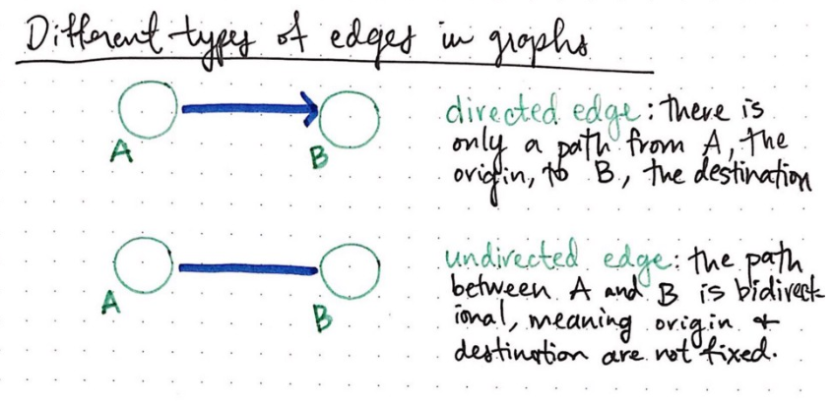
Notes:
\hat{y}=x*w+b

Slide 9
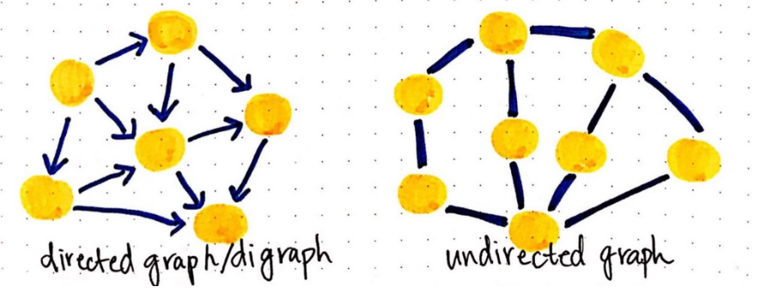

Slide 10
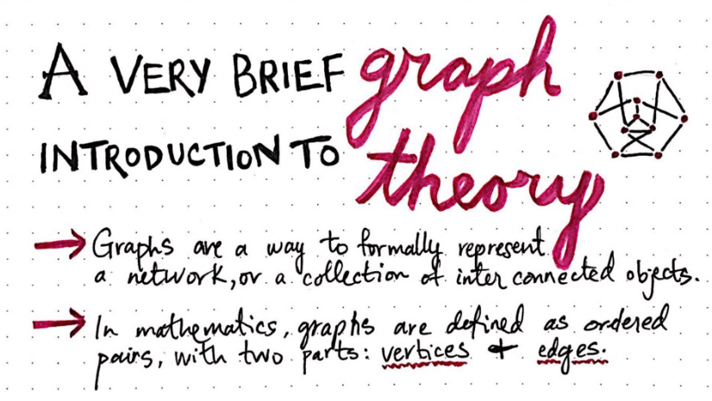

Slide 11
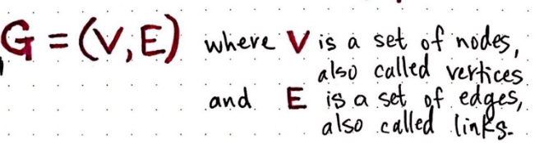

Slide 12
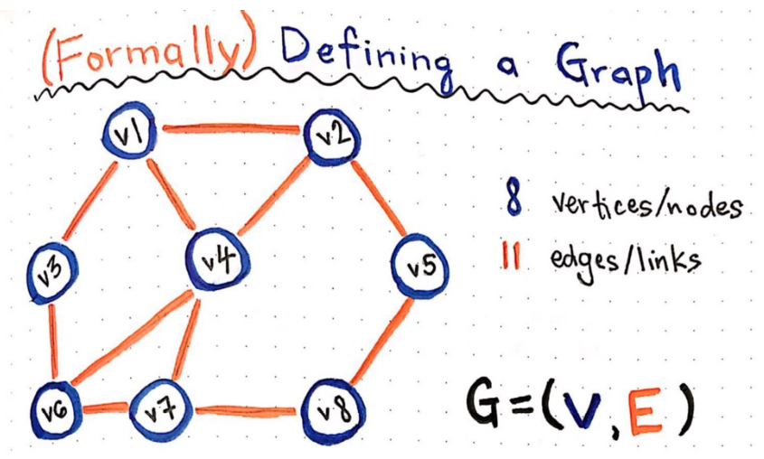

Slide 13
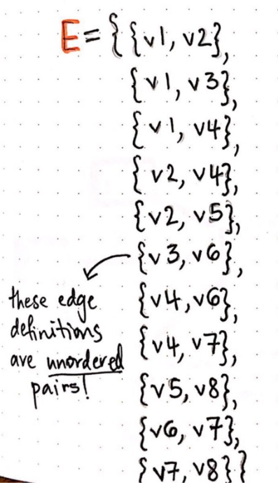
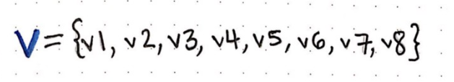

Slide 14
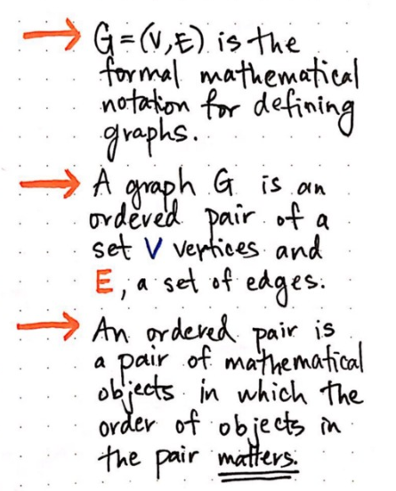

Slide 15
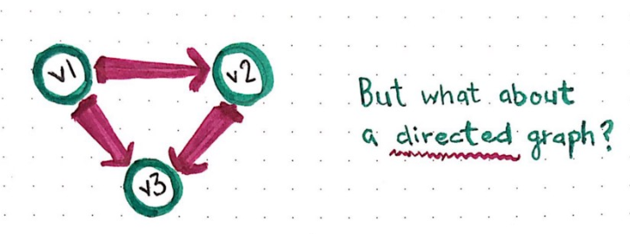

Slide 16
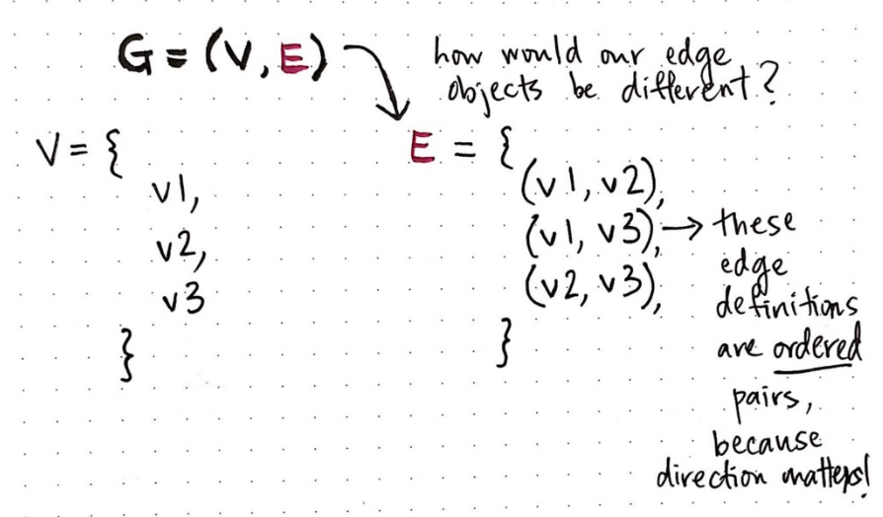

Slide 17
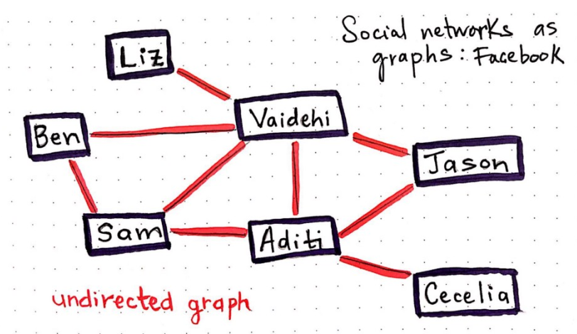

Slide 18
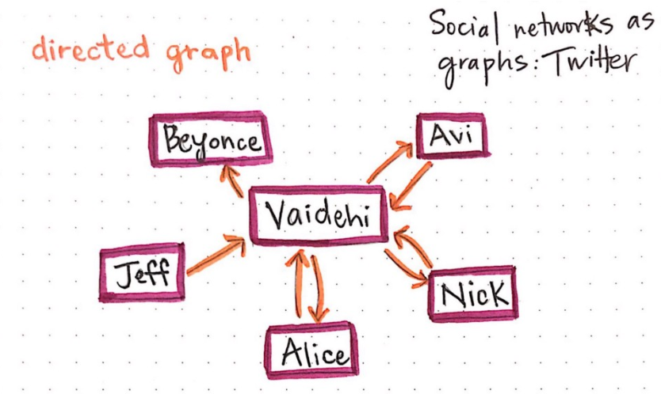

Slide 19
f(x, y, x) = (x + y) * z.

Slide 20
Deep Learning
Use statistical and mathematical ways to solve complicated math problem.

Slide 21
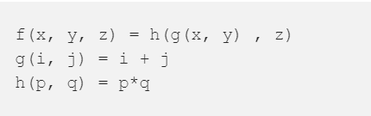

Slide 22
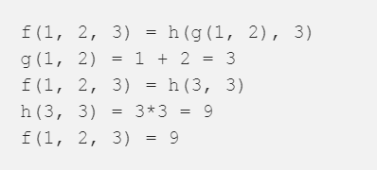

Slide 24
f(x, y, x) = (x + y) * z.

Slide 25
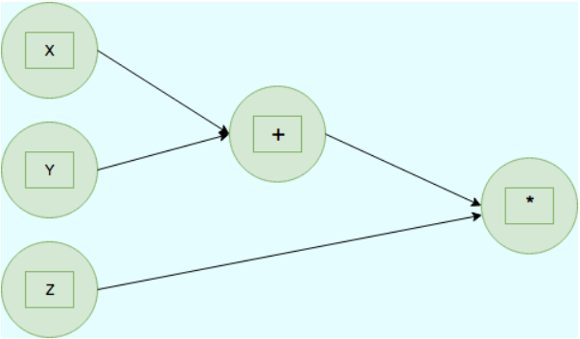

Slide 26
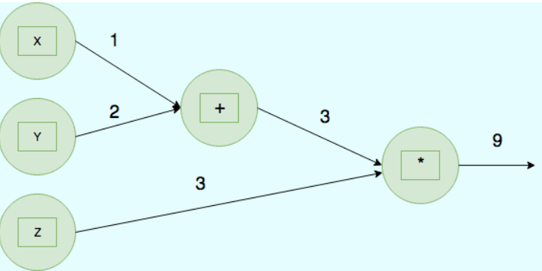

Slide 28
